Slide 1
Image Colorization Of a Photo Album by Ara Güler - Conditional GAN
-1900005528 Ahmet Kaan Memioğlu
- 1900005485 Emrecan Üzüm
- 1900003587 Şükrü Erim Sinal

Slide 2
Outline
1. ALGORITHM COMPARISON.
2. DATA SCRAPING.
3. CUSTOM DATASET CREATION.
4. DEFINING MODEL (DEFINING CONVOLUTIONAL NEURAL NETWORK.)
5. TRAINING MODEL.
6. PREDICTIONS (VISUALIZATION.)
7. COMPARISON OF PREDICTED PHOTOS.
8. CONCLUSION (WHAT WE HAVE GATHERED.)

Slide 3
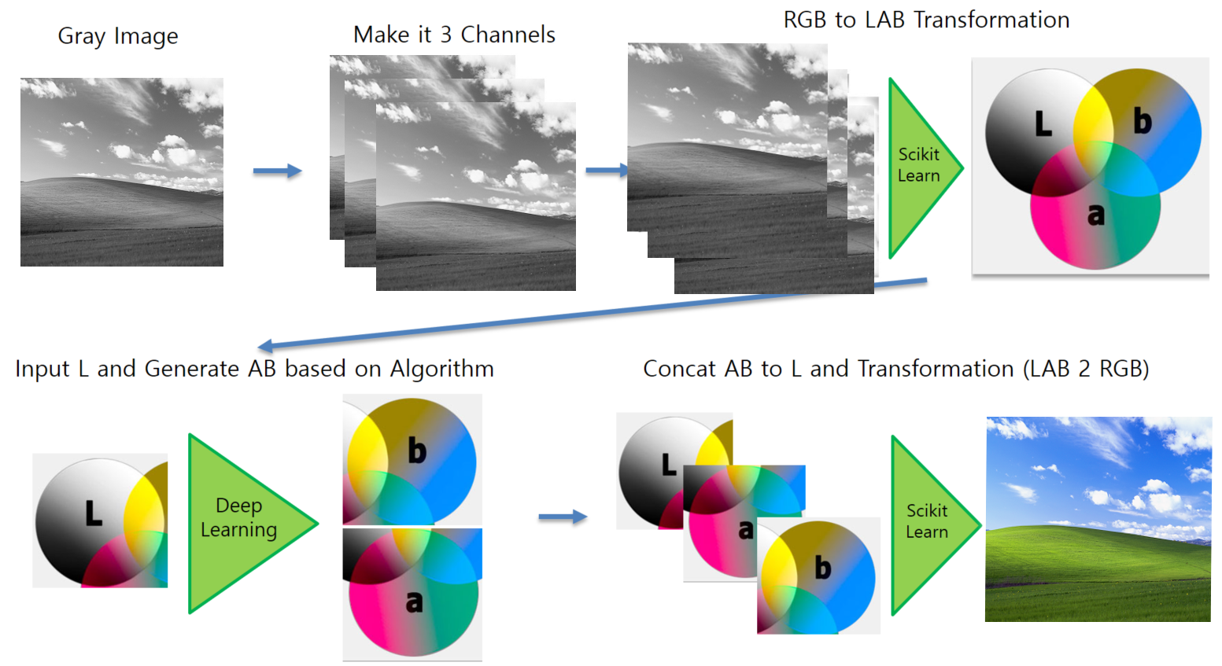
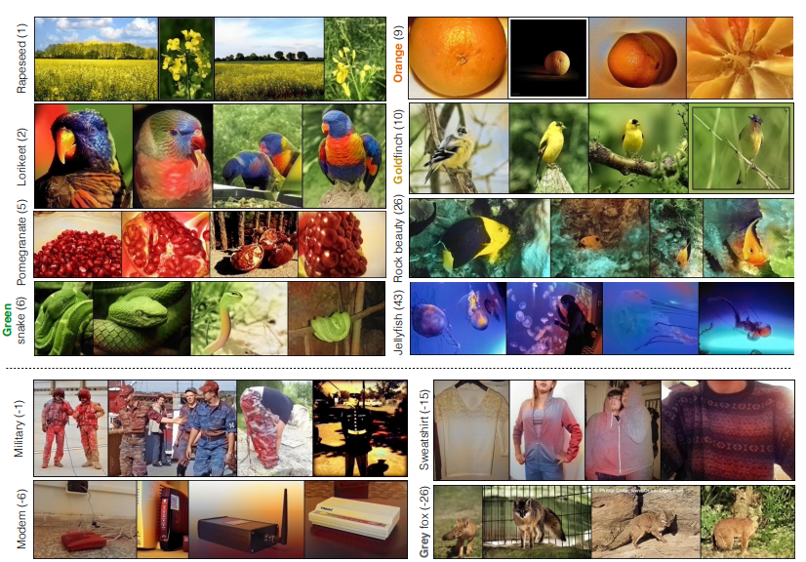
1- ) Algorithm Comparison
Our Algorithm:
Channel Division concatenation
Zhang-Phillip-Alexei Paper’s:
Class Color Rebalancing

Slide 4
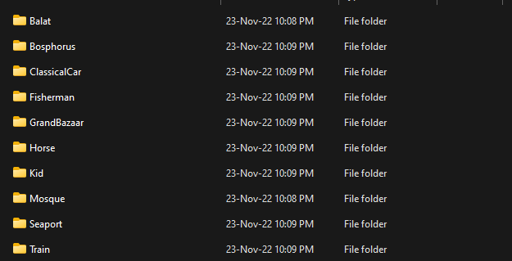
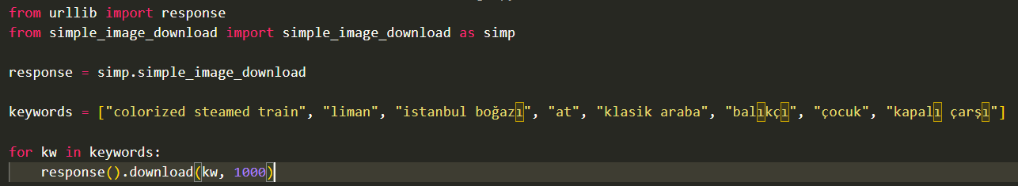
2-) Data Scraping
-Python code to collect and divide classes.
-Remove non-applausable photos
-Collect all the classes photos into a folder.

Slide 5
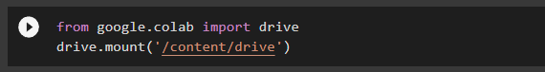
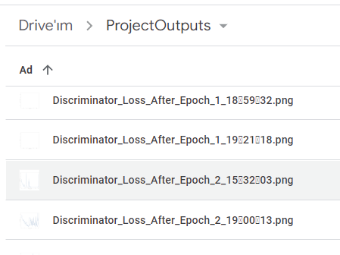
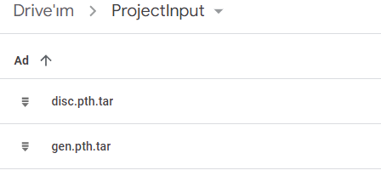
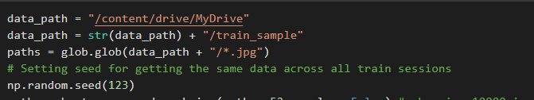
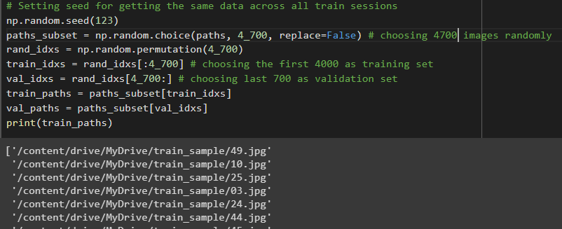
3-) Custom Dataset Creation
-Upload the folder to Google drive
-Declare the input and & output of the training to
that folder.
-Outputs of Discriminator Loss & Gen Loss gets
stored directly to drive folder.

Slide 6
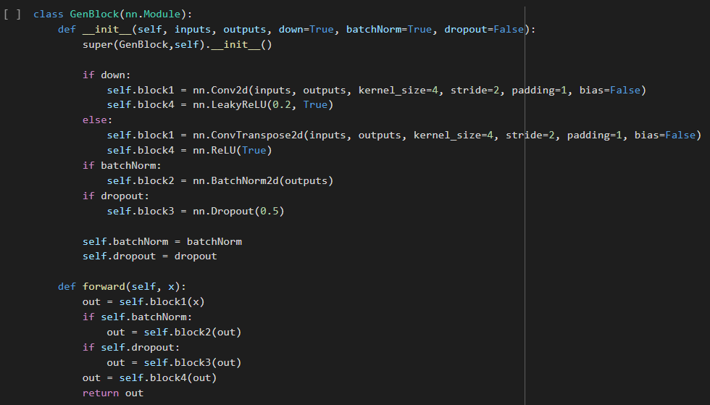
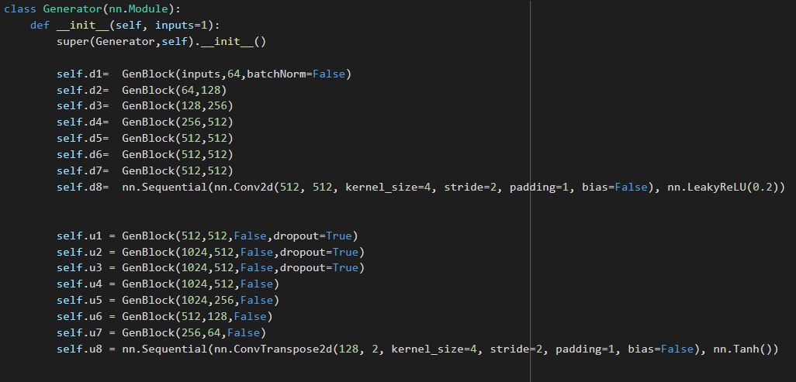
4 -) Defining Model
This is a PyTorch implementation of a Generator network for generating images. The Generator network has an encoder-decoder architecture.
The encoder part consisting of a series of GenBlock modules that downsample the input image, and the decoder part consisting of a series of GenBlock modules that upsample the encoded image.
The GenBlock module consists of several operations, including a Conv2d or ConvTranspose2d operation, a BatchNorm2d operation, a Dropout operation, and a ReLU or LeakyReLU activation.
The Generator network takes an input image of size (batch size, 1, H, W) and applies the series of GenBlock modules to generate an output image of size (batch size, 2, H, W). The output image has 2 channels because it represents a grayscale image with an additional alpha channel.
The final layer in the decoder part is a ConvTranspose2d operation followed by a Tanh activation, which scales the output image to the range (-1, 1).

Slide 7
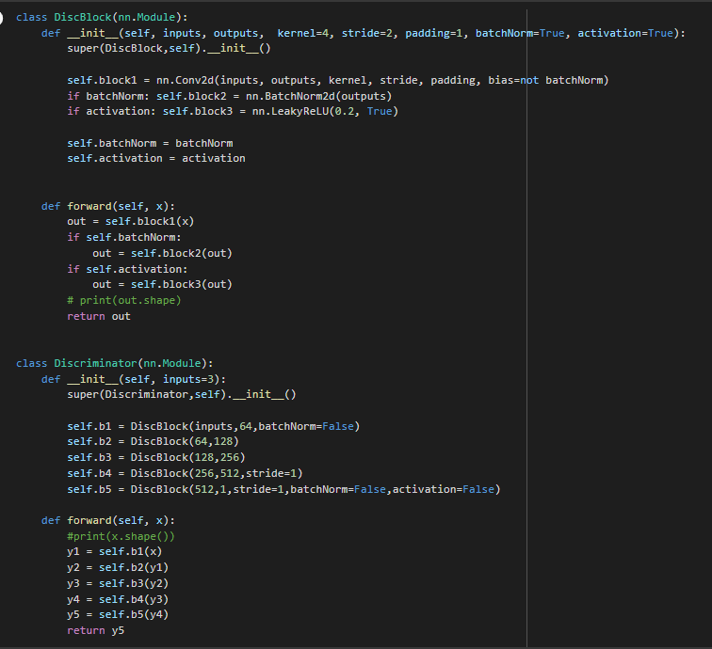
4 -) Defining Model (b)
This is a PyTorch implementation of a Discriminator network for a Generative Adversarial Network (GAN). The Discriminator network takes an input image and attempts to classify it as either real or fake.
The Discriminator network consists of a series of DiscBlock modules, each of which applies a Conv2d operation, a BatchNorm2d operation, and a LeakyReLU activation.
The Discriminator network takes an input image of size (batch size, input channels, H, W) and applies the series of DiscBlock modules to generate an output scalar of size (batch size, 1).
The output scalar represents the probability that the input image is real. If the output is close to 1, the input is classified as real, and if the output is close to 0, the input is classified as fake.
The final layer in the Discriminator network is a Conv2d operation followed by a sigmoid activation, which scales the output to the range (0, 1).

Slide 8
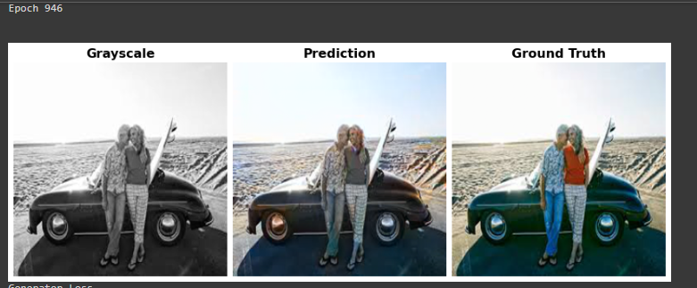
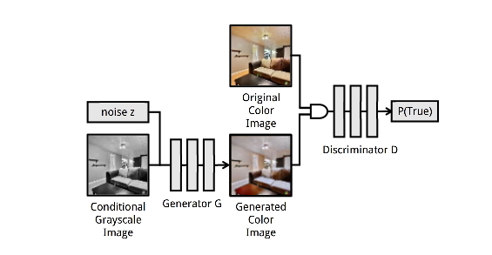
5-) Training the Model
- Bias: tends to overshoot colors.
- Bias: De-satures pinkish colors.
- Bias: Confuses red with blue time to time on bright colors.

Slide 9
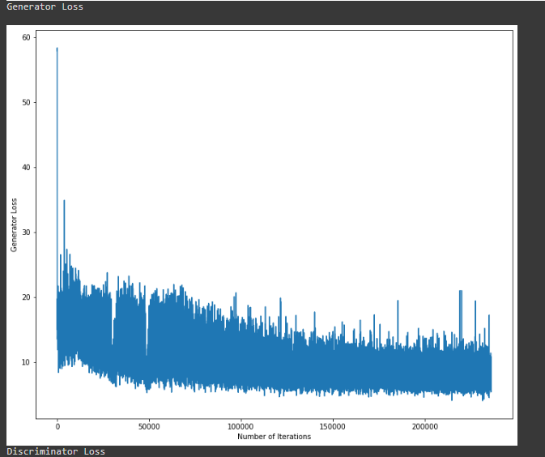
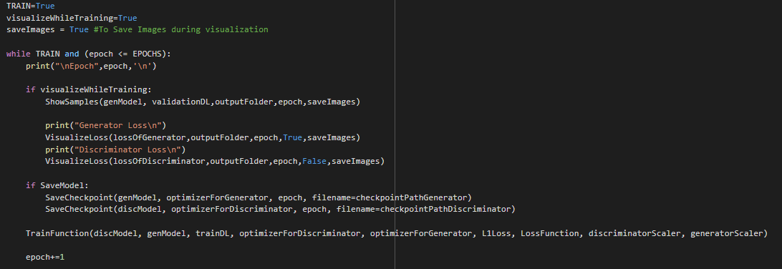
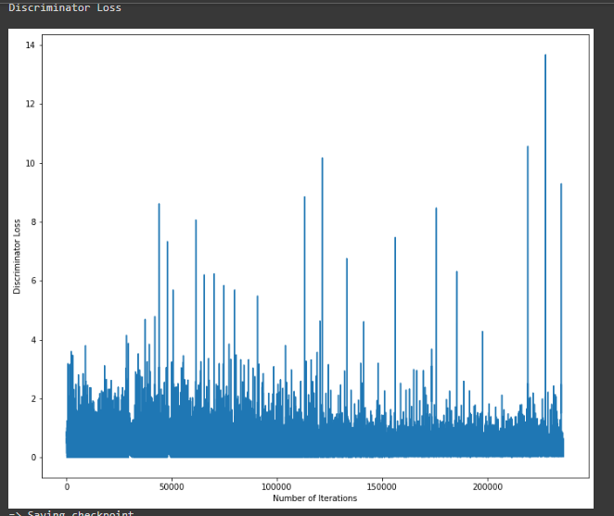
5-) Training the Model
950 epoch training.
For each epoch visualize Discriminator and Gen.
Saving each information directly to drive.

Slide 10
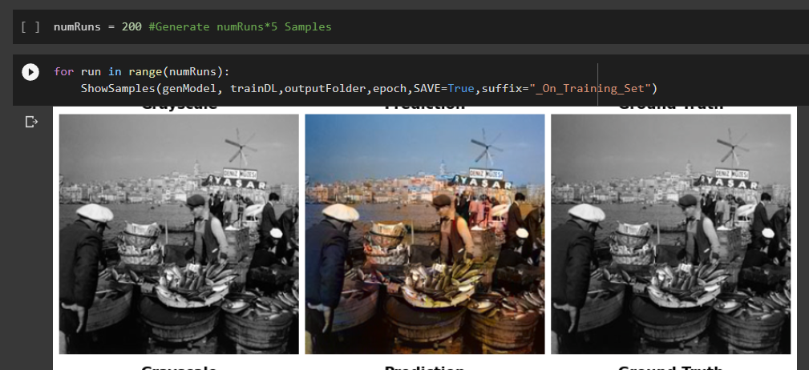
6-) Predictions

Slide 11
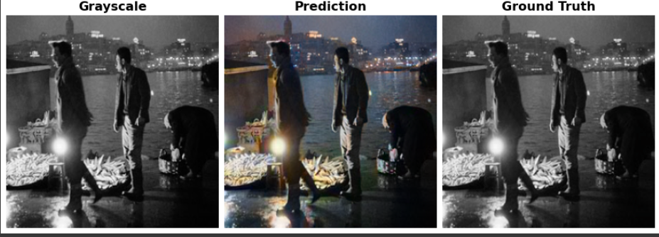
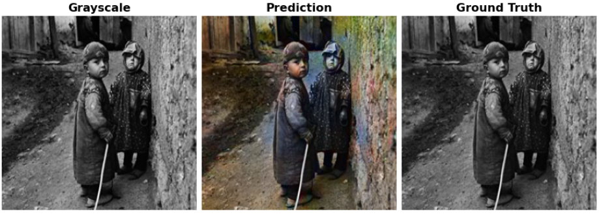
6-) Predictions

Slide 12
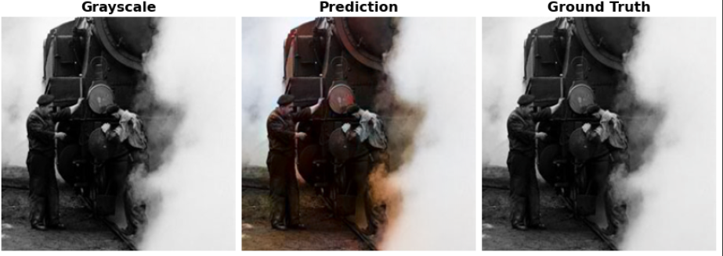
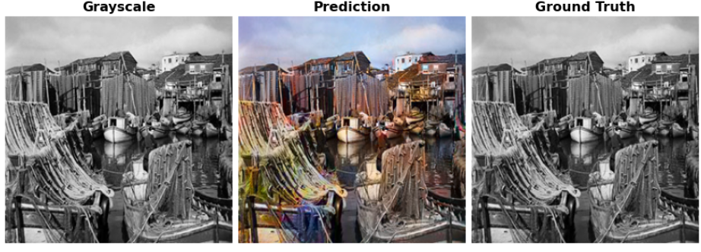
6-) Predictions

Slide 13
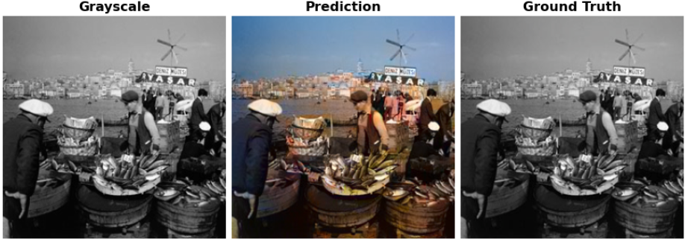
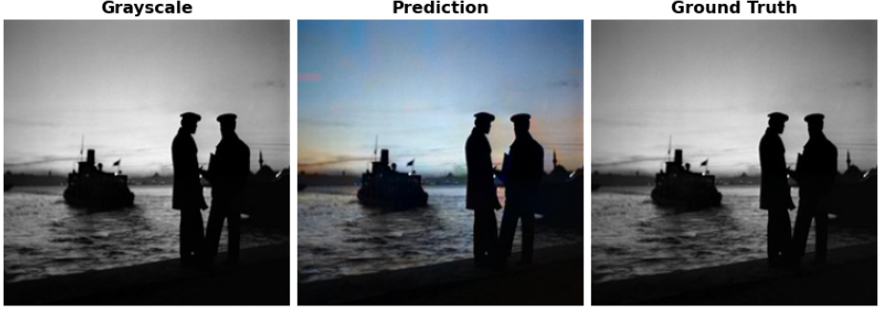
6-) Predictions

Slide 14
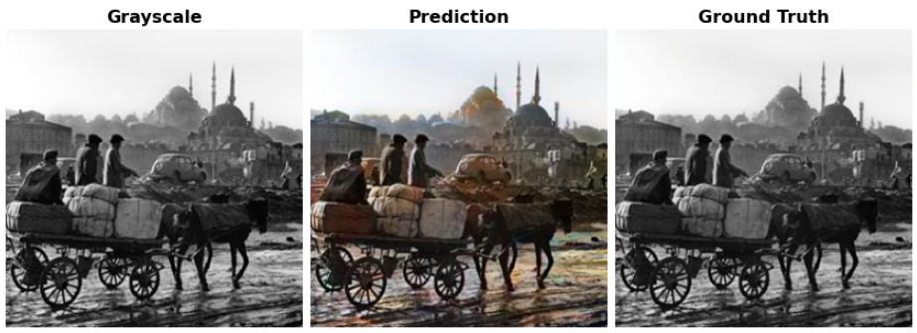
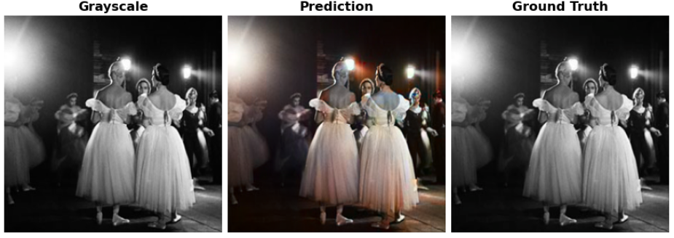
6-) Predictions

Slide 15
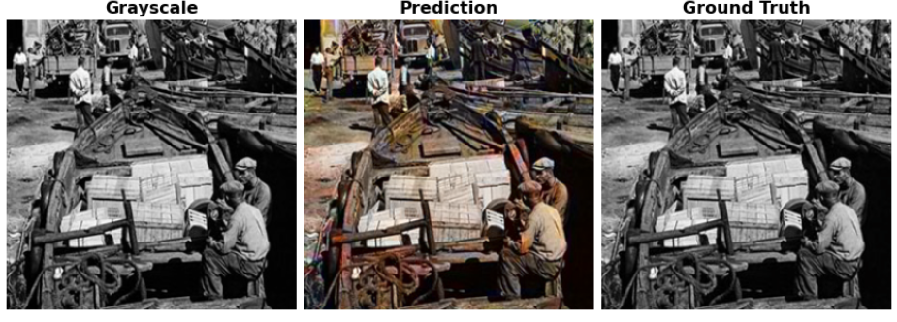
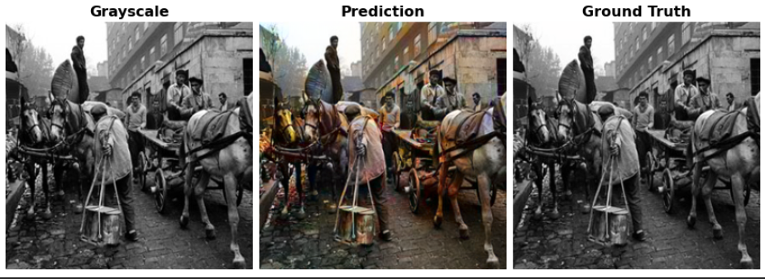
6-) Predictions

Slide 16
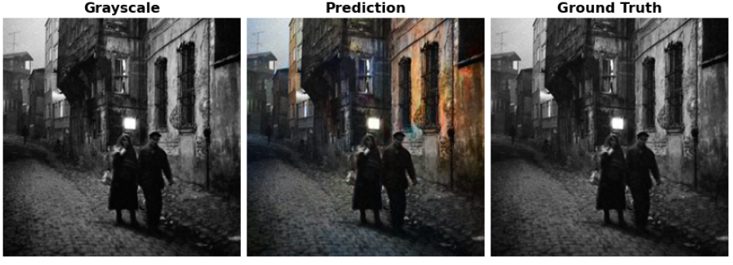
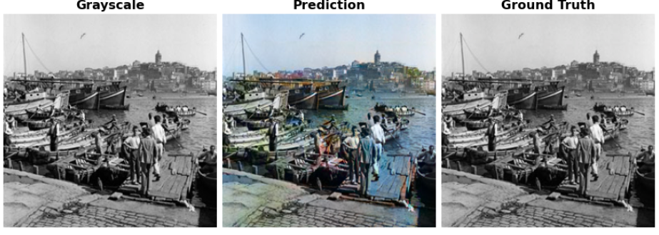
6-) Predictions

Slide 17
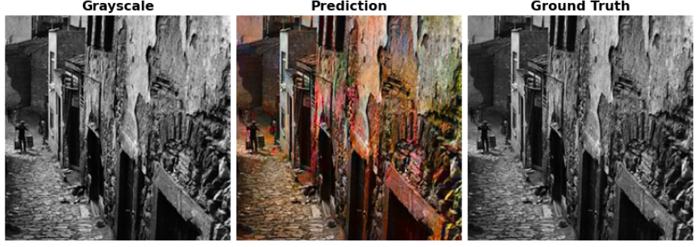
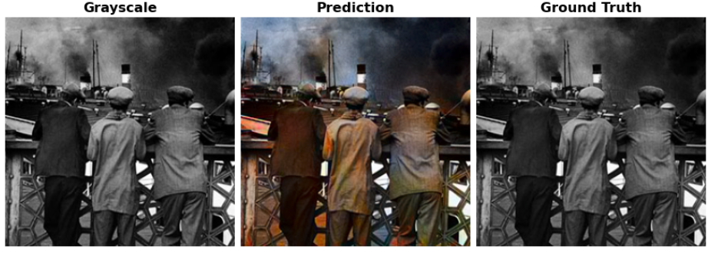
6-) Predictions

Slide 18
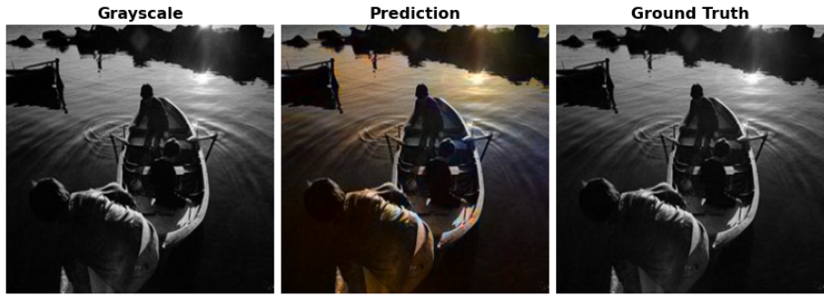
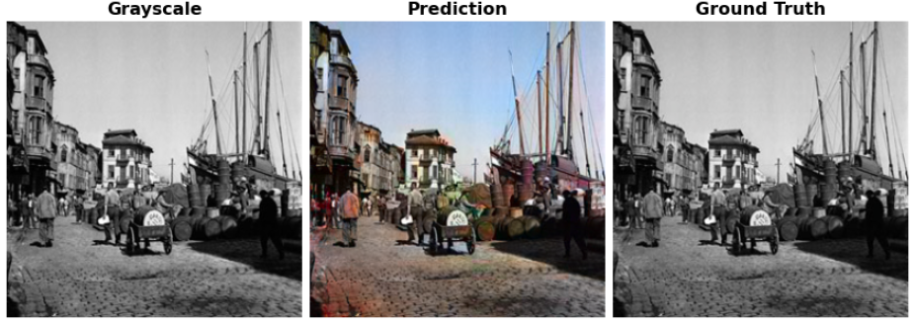
6-) Predictions

Slide 19
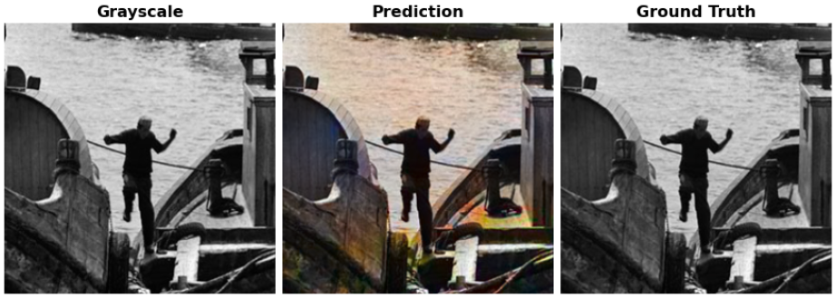
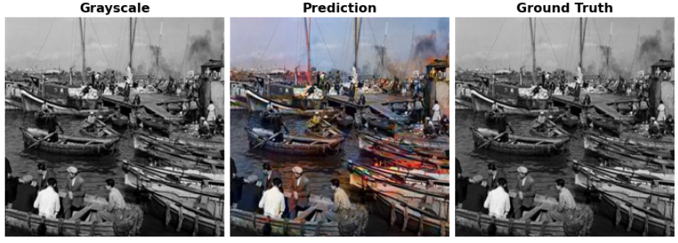
6-) Predictions

Slide 20
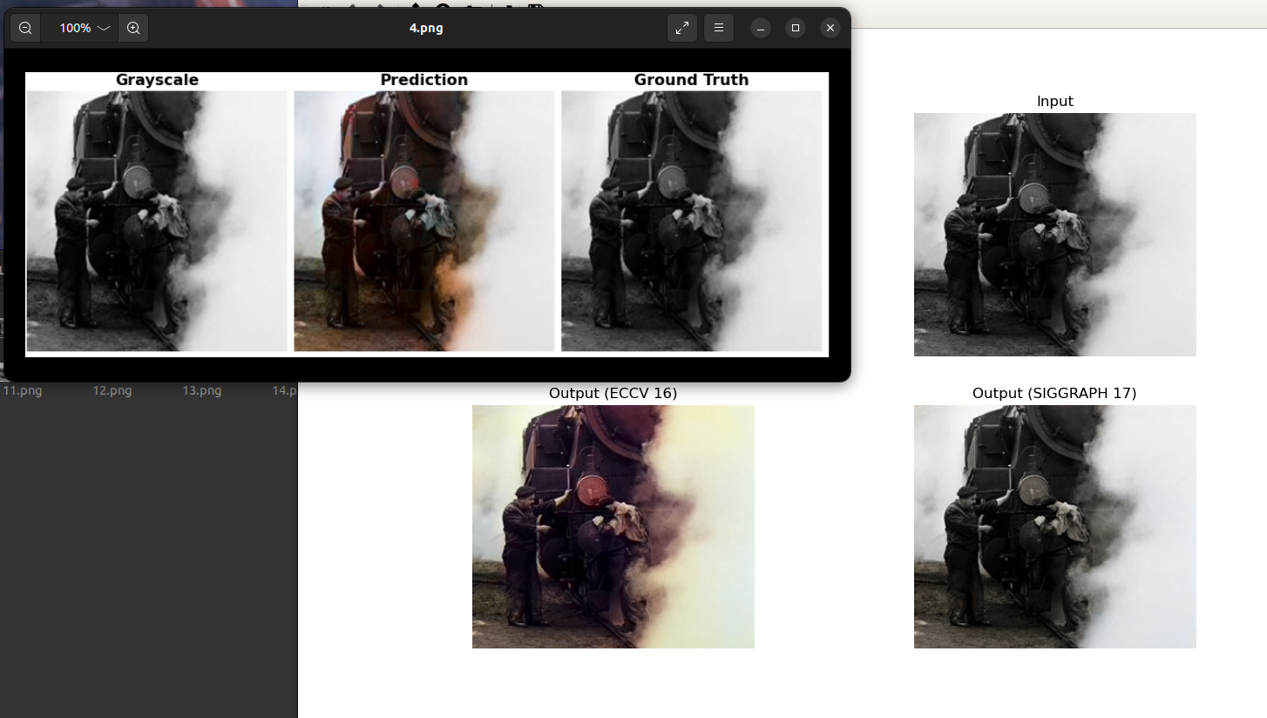
7-) Comparison of Predicted Photos

Slide 21
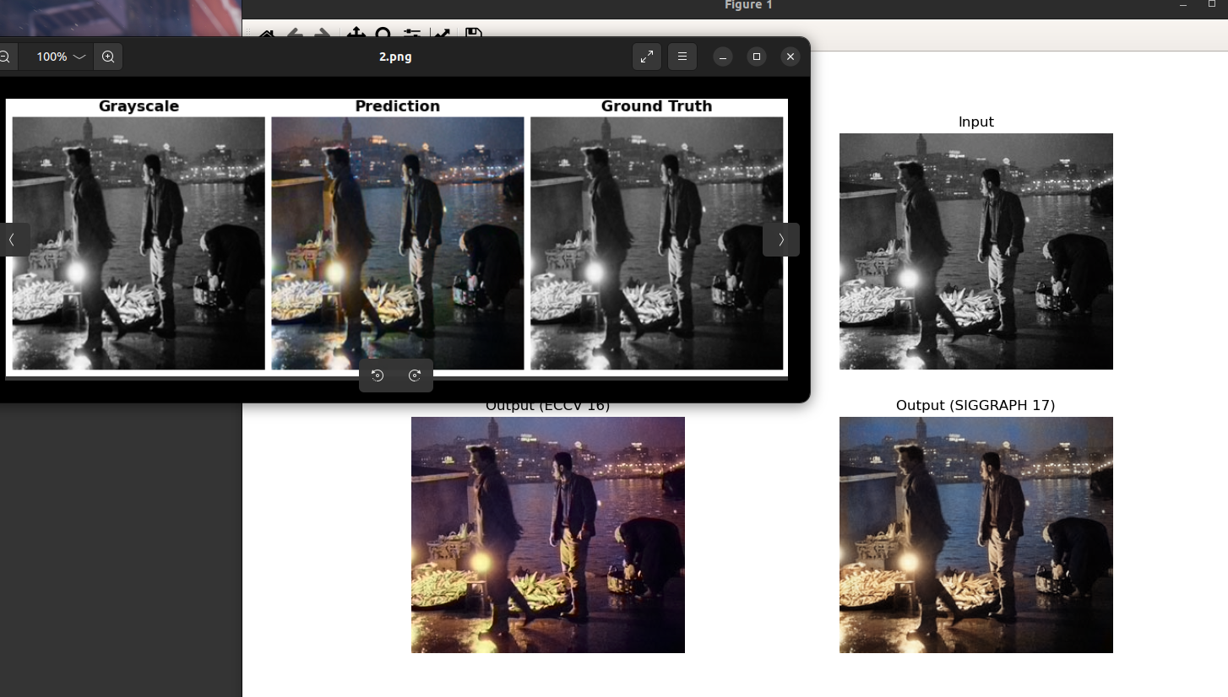
7-) Comparison of Predicted Photos

Slide 22
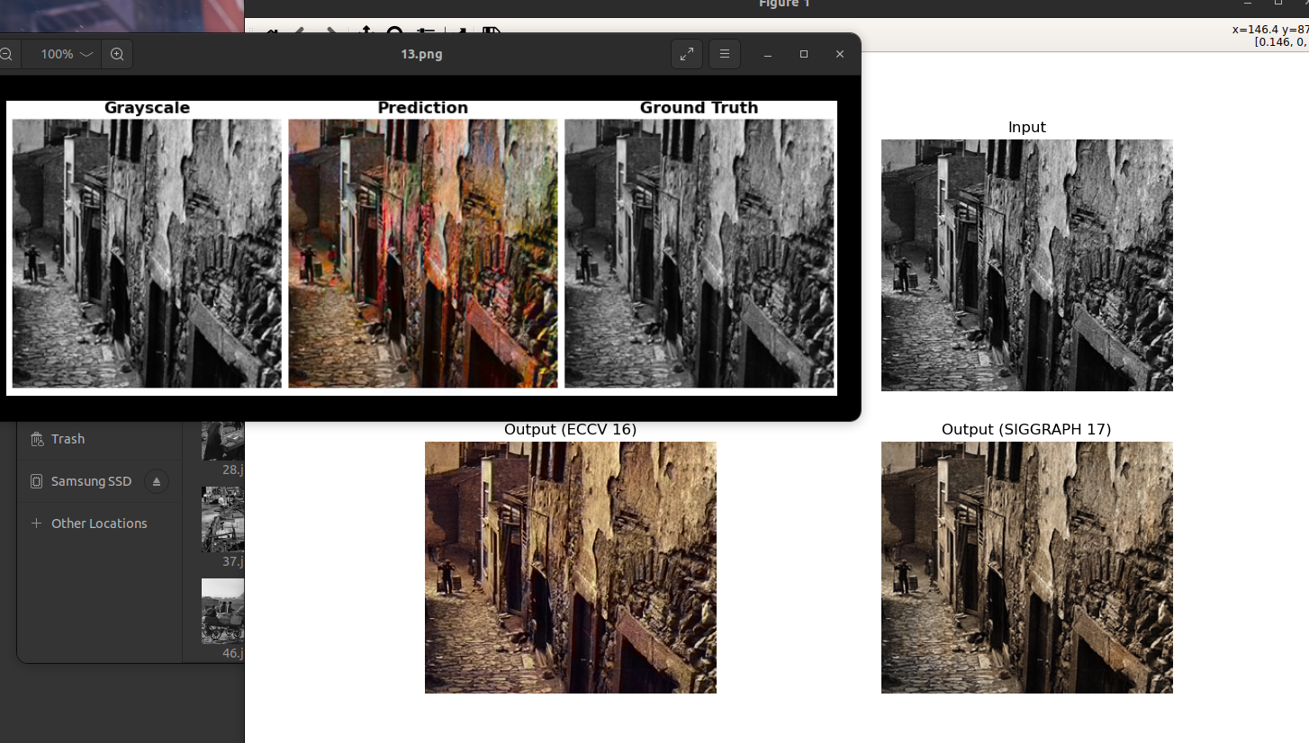
7-) Comparison of Predicted Photos

Slide 23
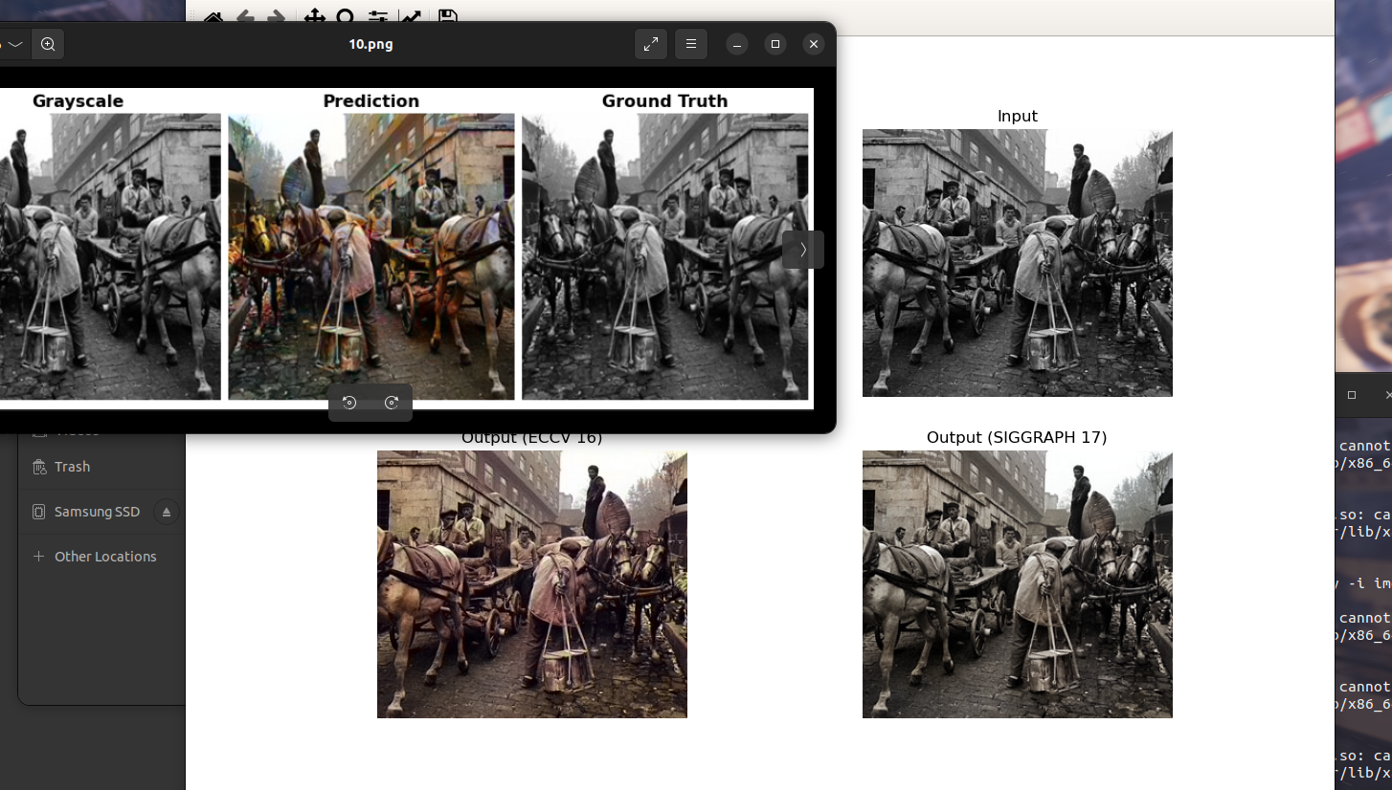
7-) Comparison of Predicted Photos

Slide 24
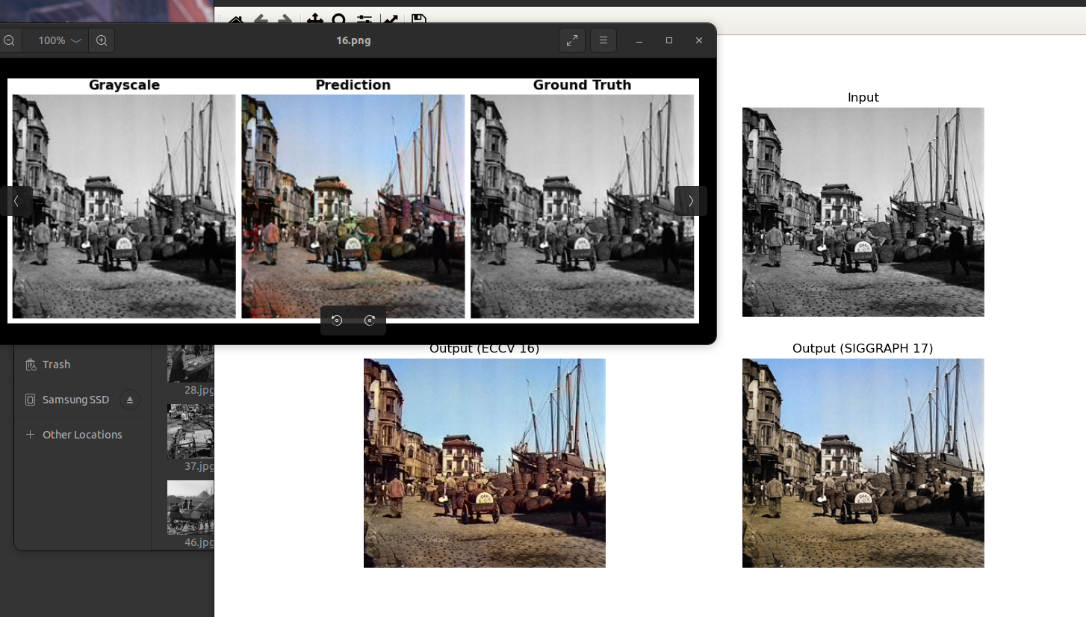
7-) Comparison of Predicted Photos

Slide 25
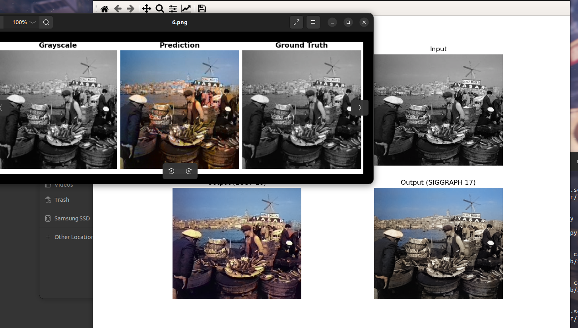
7-) Comparison of Predicted Photos

Slide 26
8-) Conclusion
What we have gathered from our experiment is despite having such a low amount of training data creating a custom dataset catered for colorization of a grey album could give visually appealing results compared to other class based and highly trained models.

